Slide 1



SMART INDIA HACKATHON 2026
Problem Statement ID –26102
Problem Statement Title-MPLAD Anomaly/Fraud/Inefficiency Detection
Theme-Transparent and intelligence governance
PS Category- Artificial Intelligence and Data Analytics
Team ID-
Team Name (NINJA WARRIORS)

Slide 2
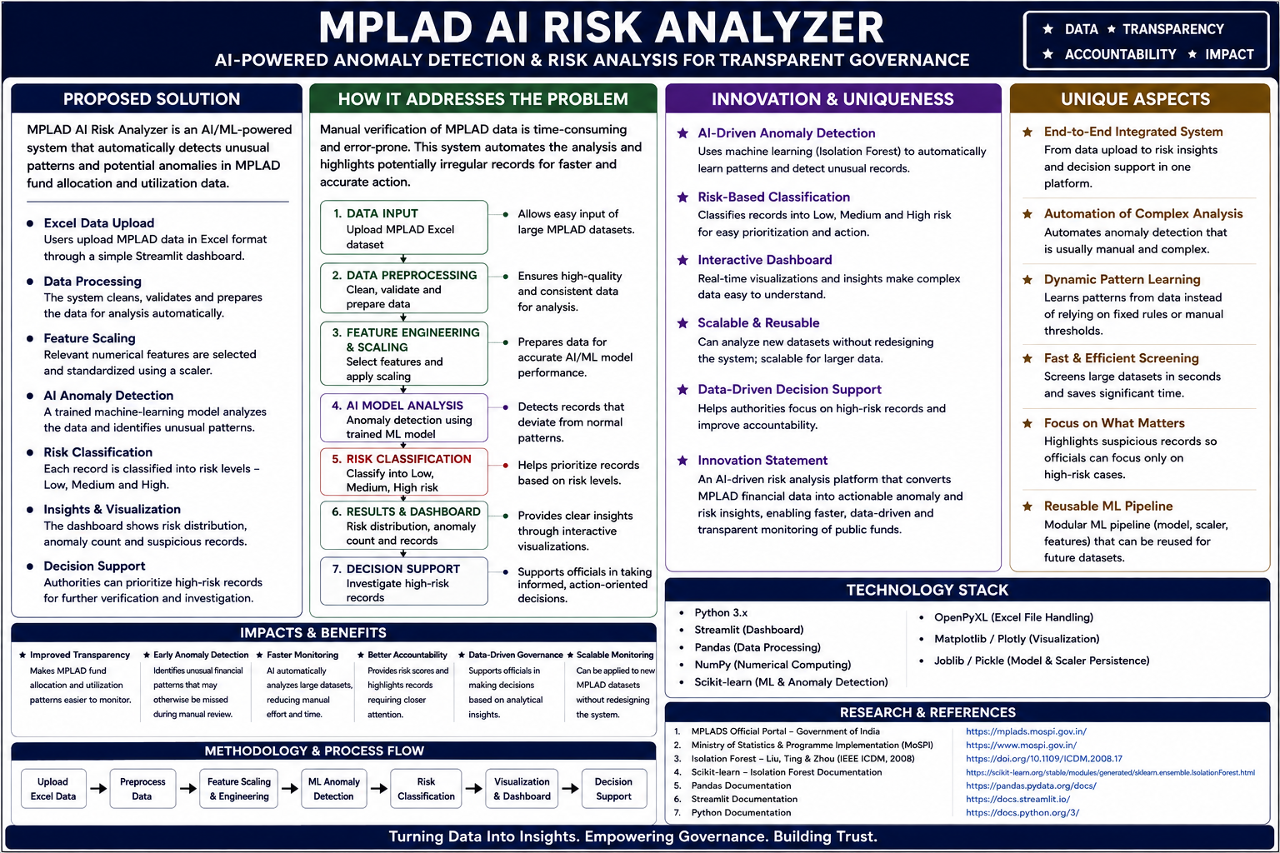
MPLAD ANOMALY DETECTION
NINJA WARRIORS
@SIH Idea submission- Template

Slide 3
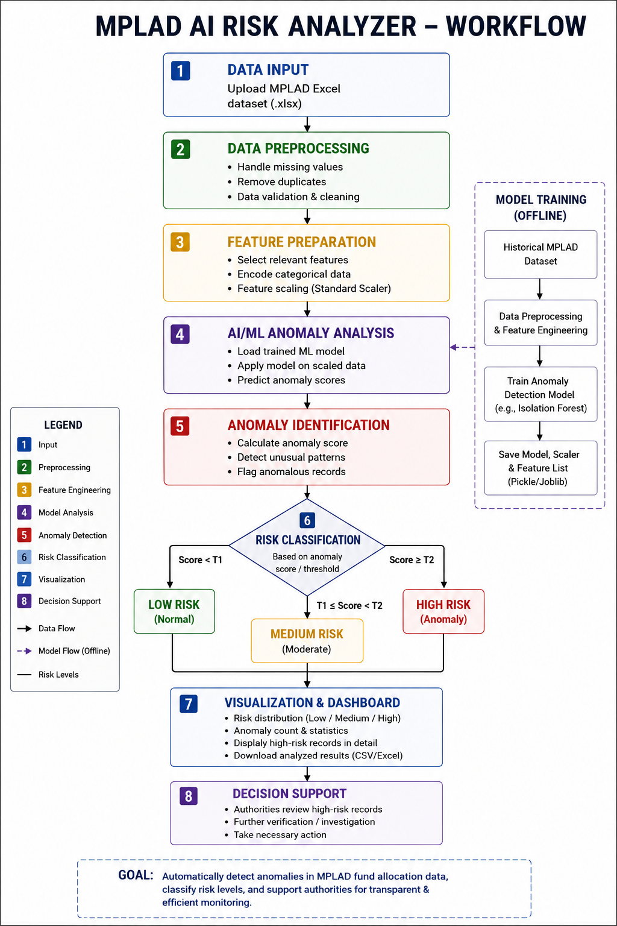
TECHNICAL APPROACH
NINJA WARRIORS
Technologies to be used:
Programming Languages:
Python 3.14.7 – Core programming language
SQL / Pandas-based data handling – For structured data processing.
Frameworks & Libraries:
Streamlit 1.62.0 – Interactive web dashboard and prototype.
Pandas – Excel/data processing
NumPy – Numerical computation
Scikit-learn – Machine-learning and anomaly detection
Pickle/Joblib – Saving and loading trained ML models
OpenPyXL – Reading Excel .xlsx datasets
Matplotlib/Plotly – Data visualization and risk charts
Hardware / Platform:
Windows PC/Laptop
Minimum 8 GB RAM recommended
Internet connection for initial setup/package installation
Runs locally through a web browser using localhost
@SIH Idea submission- Template

Slide 4
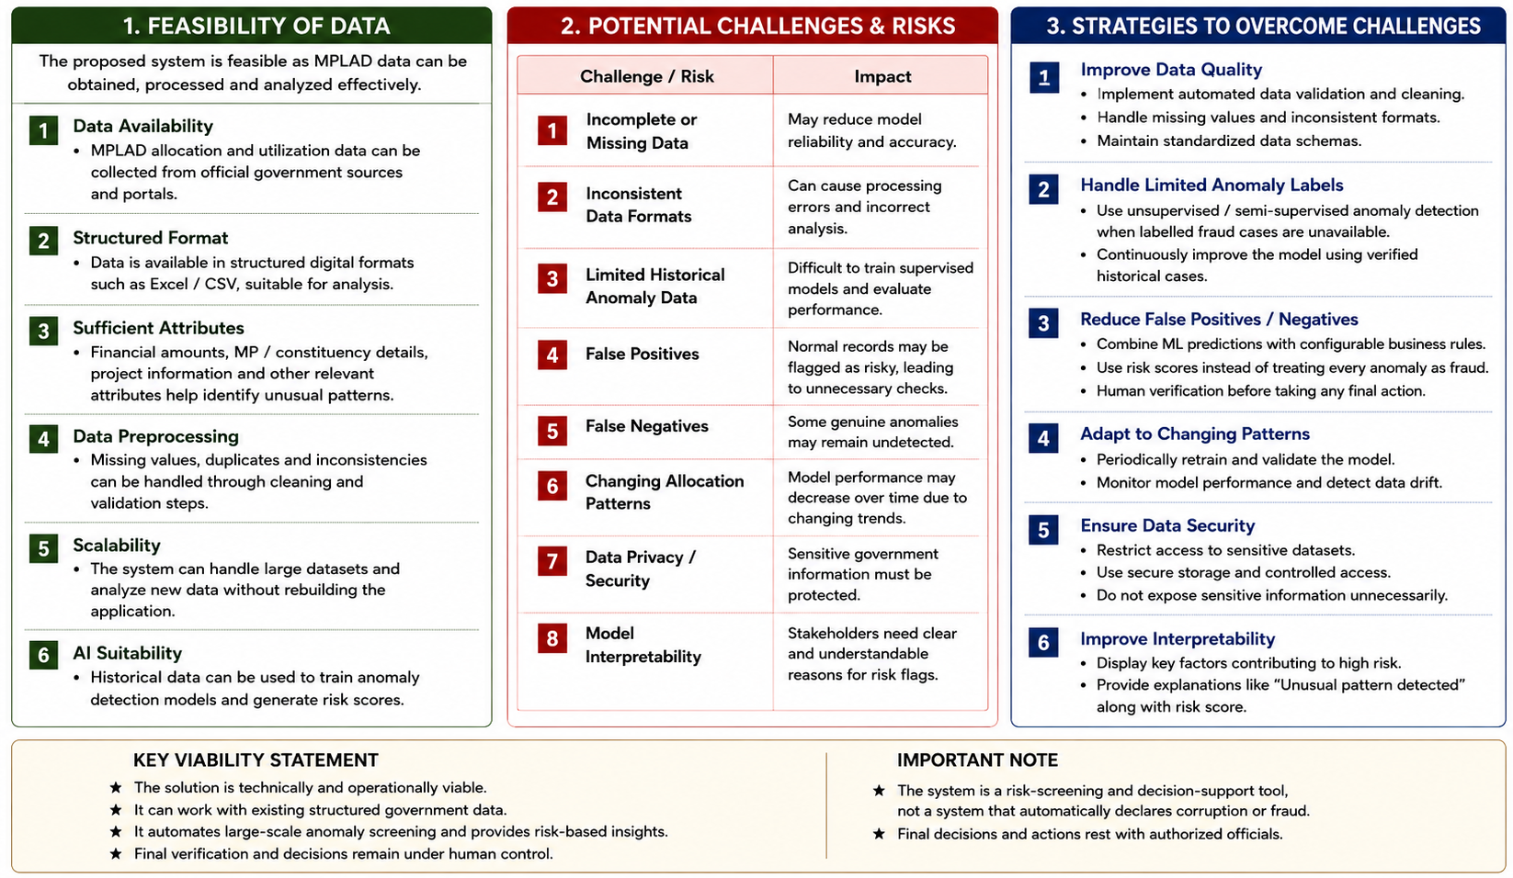
FEASIBILITY AND VIABILITY
NINJA WARRIORS
Your Team Name
@SIH Idea submission- Template

Slide 5

IMPACT AND BENEFITS
NINJA WARRIORS
@SIH Idea submission- Template

Slide 6
RESEARCH AND REFERENCES
NINJA WARRIORS
Your Team Name
1. MPLADS – Ministry of Statistics & Programme Implementation
Official Government source for MPLADS scheme, fund allocation,
implementation and monitoring.
https://www.mospi.gov.in/programme-implementation-pi-wing
2. MPLADS Official Portal
Official portal for MPLADS-related data and monitoring.
https://mplads.mospi.gov.in/
3. Isolation Forest – IEEE ICDM 2008
Research paper by Fei Tony Liu, Kai Ming Ting and Zhi-Hua Zhou.
Used as the foundation for the anomaly detection methodology.
https://doi.org/10.1109/ICDM.2008.17
4. Scikit-learn – Isolation Forest
Technical documentation for implementing Isolation Forest
for anomaly detection in Python.
https://scikit-learn.org/stable/auto_examples/ensemble/plot_isolation_forest.html
@SIH Idea submission- Template

